Slide 1
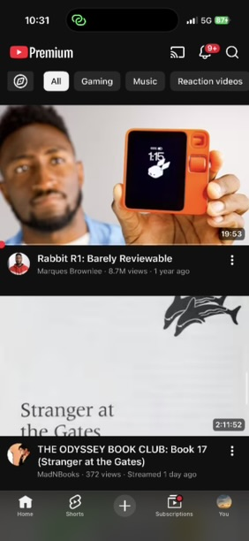
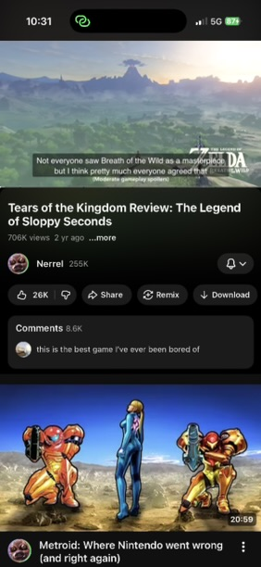


Redesigning the YouTube mobile app for the hearing-impaired
Show whether a video has manually-added closed captions or auto-generated captions for a language on the video thumbnail.
CC available: English
Audio unmuted
You’ve chosen to be notified when your device speaker is unmuted at the start of video playback. Would you like to keep it unmuted?
Mute audio Keep unmuted
CC: auto-generated
Notify the user when their audio is unmuted so they can avoid disturbing others in public spaces.

